Slide 1
Gases
Physical Characteristics of Gases:
The Kinetic Theory (a model for gases):
1. Gases consist of a large number of tiny particles with insignificant volume
2. The particles are in constant, random motion.
3. The collisions between particles and walls are elastic.
4. There are no forces of attraction or repulsion between
molecules
5. The average kinetic energy is directly proportional to
temperature in Kelvin ( __°C + 273).
Diffusion: spontaneous mixing due to random
motion (molecules moving from high concentration towards low concentration)
Effusion: gas moving through a small hole
Real Gas – a gas that does not completely behave
according to the kinetic theory
Due to: 1. Molecules occupy space
2. exert attractive forces on each other

Slide 2
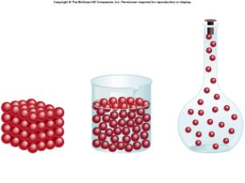
SOLID | LIQUID | GAS
Has its own shape | Takes shape of container | Fills container
Highest density | Middle density | Lowest density
Not compressible | Not compressible | Compressible
Little movement | Some movement | Rapid movement
Notes:
Don’t copy this down as notes. Simply use this as a comparison.

Slide 3
Properties (P,V,T,n)
Pressure (P): force that a gas exerts on a given area
    1 atm = 760 torr = 760 mmHg
Volume (V): space occupied by gas
    1 L = 1000 mL = 1000 cm³
Temperature (T): measure of the average kinetic energy of the gas
    MUST be in Kelvin!
    K = ˚C + 273
Number of moles (n): quantity of gas molecules
Notes:
Letters in parentheses are going to be used as symbols in equations from now on.
Must know the three sets of green equalities as conversions. Others will be given.

Slide 4
What is Pressure?
Changing the force or area will change the pressure (shoes!)
Atmospheric (air) pressure is measured by a barometer:
1 atm = 760 torr
= 760 mmHg
=1.013 x 10⁵ Pa
=101.3 kPa
STP: standard temperature and pressure. 1 atm and 0ºC
vacuum
atmospheric
pressure
mercury
Notes:
Examples:
-ballet dancer on toes vs. flat feet
-high heels vs. flats
-Kinesthetic: have students stand on both feet, one foot, tiptoes. What changed?
Practice: (HRW Modern Chem, p 312)
1. Convert a pressure of 1.75 atm to a) kPa (A: 177 kPa) and b) mmHg (A: 1330 mmHg)
Convert a pressure of 570. torr to a) atm (A: 0.750 atm) and b) kPa (A: 76.0 kPa)
4. Convert the following pressures to pressures in atm: a) 151.98 kPa, b) 456 torr, and c) 912 mmHg

Slide 5
Boyle’s Law
When T is constant: inverse relationship between P and V (one goes up… the other goes down)
A sample of oxygen gas occupies a volume of 20 mL at 2.0 atm. At what pressure will it occupy 55 mL?
Notes:
When the volume is lower, there is less area. With the same number of molecules and same T, this means that there are the same number of collisions over a smaller area. By definition, this means higher pressure.
Practice: (HRW Modern Chem, p 315)
A balloon filled with He gas has a volume of 500 mL at a pressure of 1 atm. The balloon is released and reaches an altitude of 6.5 km, where the pressure is 0.5 atm. Assuming that the temperature has remained the same, what volume does the gas occupy at this height? (A: 1000 mL He)
A gas has a pressure of 1.26 atm and occupies a volume of 7.40 L. If the gas is compressed to a volume of 2.93 L, what will its pressure be (assume constant T)? (A: 3.18 atm)

Slide 6

Charles’s Law
When P is constant: direct relationship between V and T (one goes up… the other goes up)
Notes:
In terms of collisions…
To keep pressure (or force per area) constant, the volume must increase (to increase the area of the container wall) as temperature increases the number of collisions.
Funny: There’s a fly in the ice cube that only shows up when it’s on the overhead.

Slide 7
You get a 1.7 L balloon inside at a temperature of 23˚C. At what temperature will the volume drop to 1.5 L ?
Convert initial temperature to K
  T₁ = ˚C + 273
  = 23 + 273
  = 296 K
Rearrange equation
Solve for final temperature
How cold is that?!?!
Notes:
Practice: (HRW Modern Chem, p 319)
A helium filled balloon has a volume of 2.75 L at 20 C. The volume of the balloon decreases to 2.46 L after it is placed outside on a cold day. What is the outside temperature in K? In C? (A: 262 K or -11 C)
A gas at 65 C occupies 4.22 L. At what Celcius temperature will the volume be 3.87 L, assuming constant pressure? (A: 37 C)

Slide 8
Gay-Lussac’s Law
When V is constant: direct relationship between P and T (one goes up… the other goes up)
Higher T: more collisions in same area.
A fire extinguisher has CO₂ at 22ºC and 20 atm. What is the pressure at 30ºC?
Notes:
In terms of collisions…
At constant volume and moles, a higher temperature means more collisions over the same area, meaning higher pressure.
Practice: (HRW Modern Chem, p 320)
Before a trip from New York to Boston, the pressure in an automobile tire is 1.8 atm at 20 C. At the end of the trip, the pressure guage reads 1.9 atm. What is the new Celcius temperature of the air in the tire, assuming constant volume? (A: 36 C)
At 120.C, the pressure of a sample of nitrogen is 1.07 atm. What will the pressure be at 205 C, assuming constant volume? (A: 1.30 atm)

Slide 9
Practice!
First 3 “Worksheets”

Slide 10
Combined Gas Law
True when moles are constant
Use to remember
  Boyle’s law:
  Charles’s law:
  Gay-Lussac’s law:
A balloon has a volume of 20.0 L at 23ºC and 770 torr. What will its volume be at 685 torr and 25ºC?
Notes:
Practice: (HRW Modern Chem, p 322)
The volume of a gas is 27.5 mL at 22.0 C and 0.974 atm. What will the volume be at 15.0 C and 0.993 atm? (A: 26.3 mL)
A 700. mL gas sample at STP is compressed to a volume of 200. mL, and the temperature is increased to 30.0 C. What is the new pressure of the gas in kPa? (A: 394 kPa)

Slide 11
Ideal Gas Law
PV=nRT
R is the gas constant. It will always have the same values.
You must know which one to use
R = 8.314 kPa L K⁻¹ mol⁻¹ if Pressure is in kilopascals(kPa), Volume is in liters(L), Temperature is in Kelvin(K)
R = 0.0821 L atm K⁻¹ mol⁻¹ if Pressure is in atmospheres(atm), Volume is in litrers(L), Temperature is in Kelvin(K)

Slide 12
Ideal Gas Law
What volume is needed to store 0.050 moles of helium gas at 202.6 kPa and 400 K?
What pressure will be exerted by 20.16 g hydrogen gas in a 7.5 L cylinder at 20ºC?
A 50 L cylinder is filled with argon gas to a pressure of 10130.0 kPa at 30ºC. How many moles of argon gas are in the cylinder?
To what temperature does a 250 mL cylinder containing 0.40 g helium gas need to be cooled in order for the pressure to be 253.25 kPa?
Notes:
What volume is needed to store 0.050 moles of helium gas at 202.6kPa and 400K?PV = nRTP = 202.6 kPa
n = 0.050 mol
T = 400K
V = ? L
R = 8.314 J K-1 mol-1202.6V=0.050x8.314x400
202.6 V = 166.28
V = 166.28 ÷ 202.6
V = 0.821 L
What pressure will be exerted by 20.16g hydrogen gas in a 7.5L cylinder at 20oC?PV = nRTP = ? kPa
V = 7.5L
n = mass ÷ MM
mass=20.16g
MM(H2)=2x1.008=2.016g/mol
n=20.16 ÷ 2.016=10mol
T=20o=20+273=293K
R = 8.314 J K-1 mol-1Px7.5=10x8.314x293
Px7.5 = 24360.02
P = 24360.02 ÷ 7.5 = 3248kPa
A 50L cylinder is filled with argon gas to a pressure of 10130.0kPa at 30oC. How many moles of argon gas are in the cylinder?
PV = nRTP = 10130.0kPa
V = 50L
n = ? mol
R = 8.314 J K-1 mol-1
T=30oC=30+273=303K10130.0x50=nx8.314x303
506500=nx2519.142
n=506500 ÷ 2519.142=201.1mol
To what temperature does a 250mL cylinder containing 0.40g helium gas need to be cooled in order for the pressure to be 253.25kPa?
PV = nRTP = 253.25kPa
V=250mL=250 ÷ 1000=0.250L
n=mass ÷ MM
mass=0.40g
MM(He)=4.003g/mol
n=0.40 ÷ 4.003=0.10mol
R = 8.314 J K mol-1
T = ? K253.25x0.250=0.10x8.314xT
63.3125 = 0.8314xT
T=63.3125 ÷ 0.8314=76.15K

Slide 13
Dalton’s Law of
Partial Pressure
The total pressure of a gas sample is equal to the sum of the partial pressures of individual gases.
Example: Earth’s atmosphere
Gas | Pressure (torr)
N₂ | 593.5
O₂ | 159.2
Ar | 7.1
CO₂ | 0.23
Total | 760
Notes:
Show electrolysis of water. Have students figure out which gas is in each tube based on reaction. Talk about water vapor. Introduce table in the appendix and show how to solve collection over water problems in this way.

Slide 14
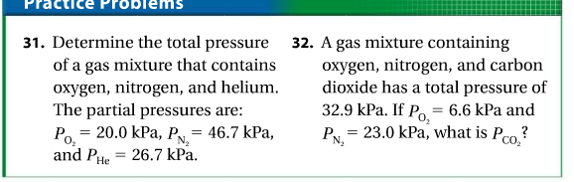
93.4 kPa
3.3 kPa

Slide 15
Gases You Know
N₂
  The most common gas in our atmosphere (78%)
  Not reactive
O₂
  20% of the atmosphere
  Supports combustion
CO₂
  Greenhouse gas
  More dense than air
  Used in fire extinguishers
H₂
  Very low density
  Explosive if mixed with O₂
Notes:
Relate to atmosphere and previous lab activities. Good to have a brainstorm before showing this slide.
Carbon dioxide density demo:
Materials: 1 200-250 mL beaker, 1 small jar (to use as stand), 1 tea light candle, baking soda, vinegar
Put the small jar in the beaker. Pour ~1/2” baking soda around the jar. Place the candle on top of the jar and light before class. Show students that it has been lit for a while. Ask if any have ever made a volcano before and have them describe what they used and what happens. Have them predict what will happen when you pour the vinegar in. Have students in the front pay close attention. The flame should go out from the bottom up.

Slide 16
P
T
V
Boyle’s Law
P
T
V
Charles’s Law

Slide 17
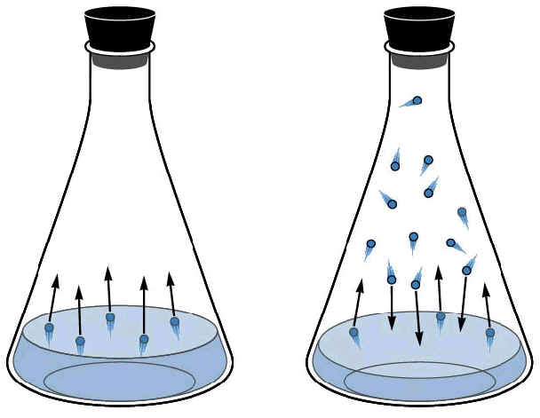
Vapor Pressure and Boiling
Vapor Pressure – the pressure exerted by a vapor in equilibrium with its liquid state.
Liquid molecules at the surface escape into the gas phase.
These gas particles create pressure above the liquid in a closed container.
Vapor Pressure Explained (Vid)

Slide 18
The condition in which two opposing processes are occurring simultaneously at equal rates is called a dynamic equilibrium. A liquid and its vapor are in equilibrium when evaporation and condensation occur at equal rates. This can only be obtained in a closed container.

Slide 19
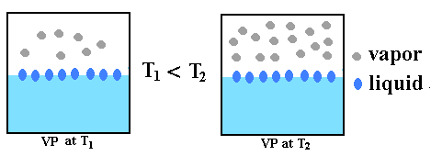
Vapor Pressure increases with increasing temperature.
20ºC
80ºC
As temperature increases, the amount of vapor generated by a liquid in a closed container increases.
This occurs because as the liquid gains kinetic energy, the molecules can overcome the intermolecular forces of attraction that are prevalent in the liquid phase.

Slide 20
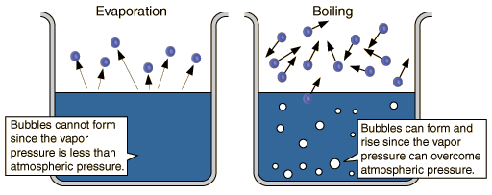
Evaporation vs Boiling
Evaporation - when a liquid → gas at any temperature
Vaporization – When a liquid → gas when heat is applied or at the boiling temperature
Boiling – occurs when the vapor pressure above the liquid equals the atmospheric pressure.

Slide 21
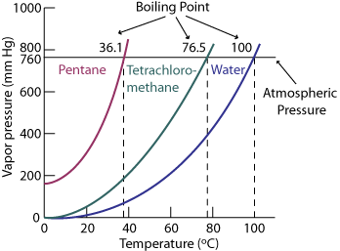
Vapor Pressure Curves
Graph shows how boiling points change with change in vapor pressure.

Slide 22
Boiling Points change with pressure changes.
Less pressure = lower boiling point temperature (example = water boils at lower temperatures at high elevations- water boils at 76ºC on Mt. Everest).
Higher Pressure = higher boiling point temperature (example = pressure cooker – cooks faster because you cook at a higher temperature.)

